Slide 1

Final Project of INFO 6250
Web Development Tools & Methods INFO6250, Spring 2019, Northeastern University
Xuyang Li NUID: 001409590
Jiaao YU NUID: 001464004

Slide 2
Project Overview
Frontend(Angular) Architecture
Backend Architecture
Special Features

Slide 3
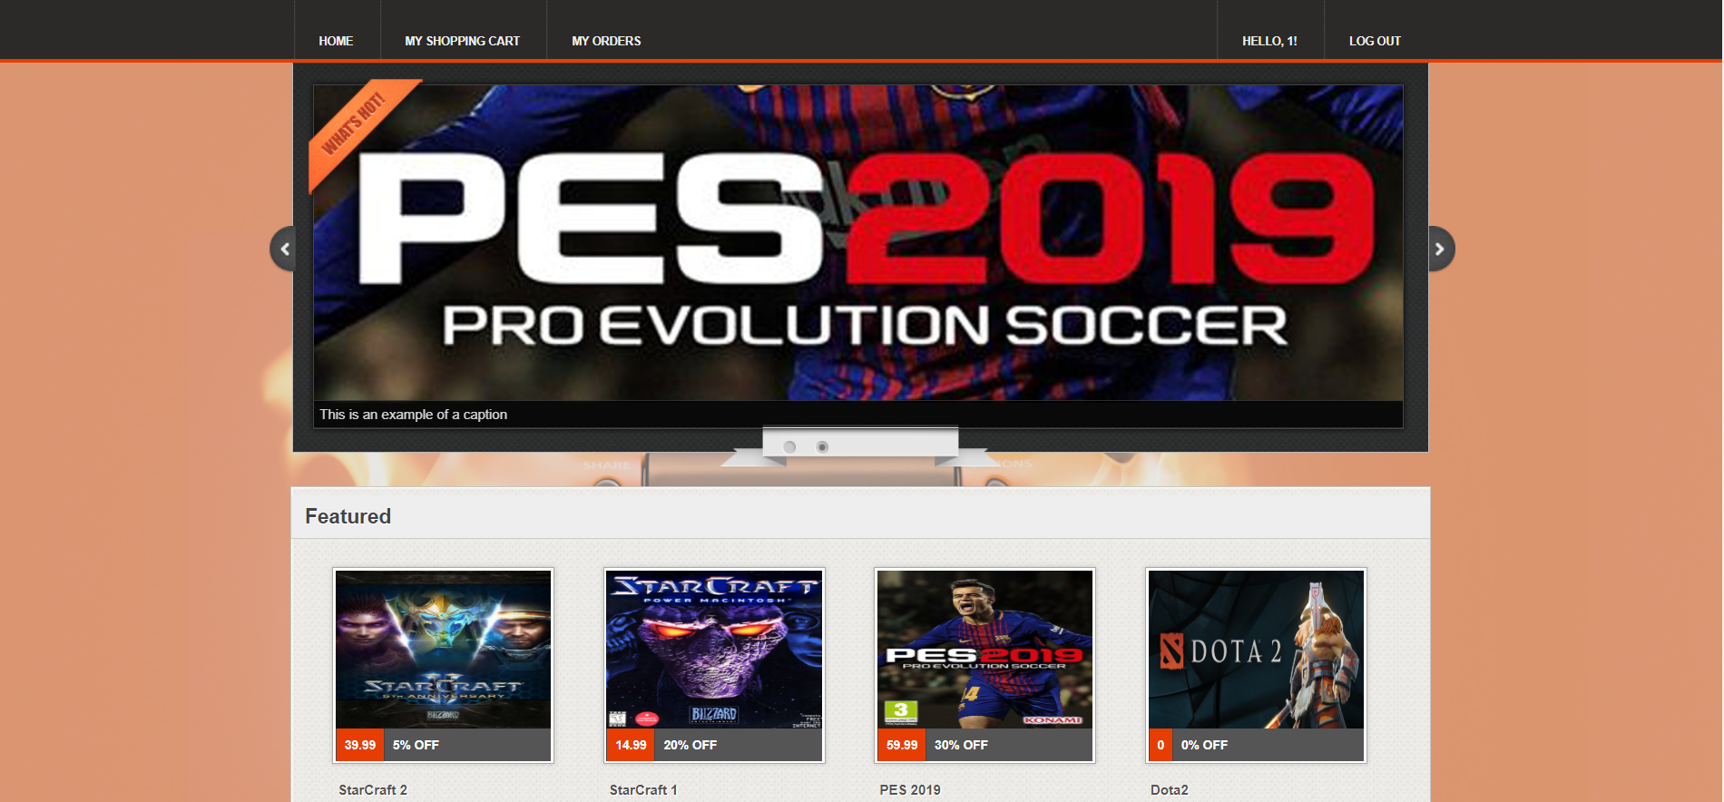
Project Overview: Develop a shopping website for selling computer games!

Slide 4
Frontend(Angular) Architecture
*src
+---*app
+---*log-login
+---*log-register
+---*log-toolbar
+---*shop-itemlist
+---*shop-itemdetail
+---*shop-cart
+---*shop-checkout
+---*shop-orderlist
+---*shop-orderdetail
+---*shop-toolbar
+---*game
+---*shared
+---*models (several classes used to communicate with the API)
+---*services
+---app-service.service
+---routeguard-service.service

Slide 5
Backend Architecture---WebAPI
*Controllers
+---*AccountController
+---*ItemsController
+---*ImageController
+---*OrderController
+---*FormalOrderController
*Managers
+---*AccountManager
+---*ItemManager
+---*OrderManager
+---*FormalOrderManager
*Models(several classes used to communicate with the client)

Slide 6
Backend Architecture---Database
*DB
+---*Database
+---*Orders
+---(username).json
+---*account.json
+---*items.json
+---tempOrder.json
+---*Rescources (several images of the game items)

Slide 7
Special Features---Powerful Shopping Website
As a user, I can register a account and login with the account.
As a user, I can buy a item, add it to the cart and remove it.
As a user, I can proceed to checkout the order, give the shipping address and payment information and place the order.
As a user, I can review all the orders that I once placed and view the detail of the order.
Time for the demo!

Slide 8
Special Features---Shopping Cart State is Stored (TempOrder)
When you add some items to the shopping cart but don’t place the order, we store the state of the shopping cart by using “tempOrder”.
Time for the demo!

Slide 9
Special Features---Perfect Account Register/login Functionalities
You cannot register a account with username that has already existed.
You cannot login with a wrong password or non-existed account.
You will be notified by pop-up messages. (https://www.npmjs.com/package/toastr)
Time for the demo!

Slide 10
Special Features---RouterGuard Protects the Website Access
We have a RouterGuard service which controls the behavior of the routing. You cannot access the website (except login and register) without logging in, even if you modify the URL.
Time for the demo!

Slide 11
Special Features---Deployment with Packer and Terraform
The WebAPI part is deployed on Azure .
The Angular part is deployed on AWS using Packer and Terraform.

Slide 12
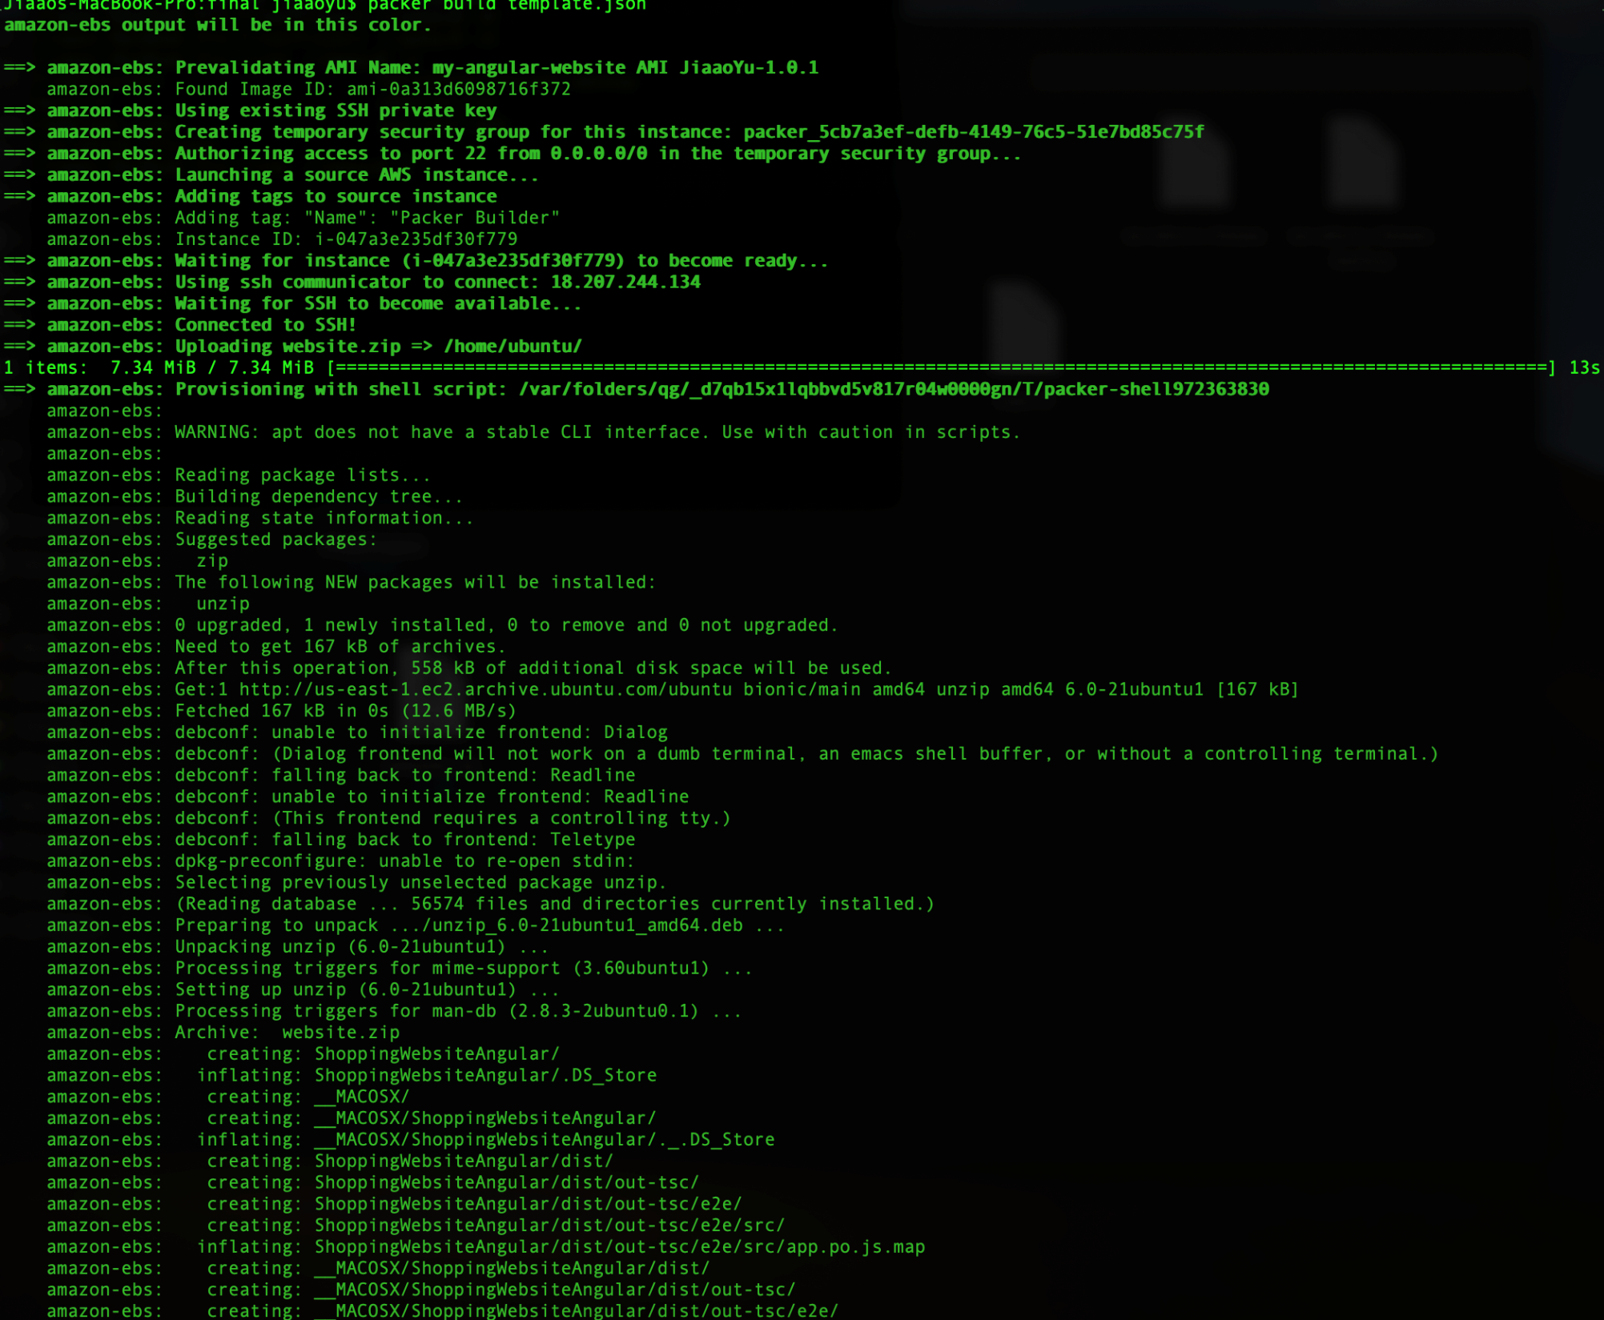

Slide 13
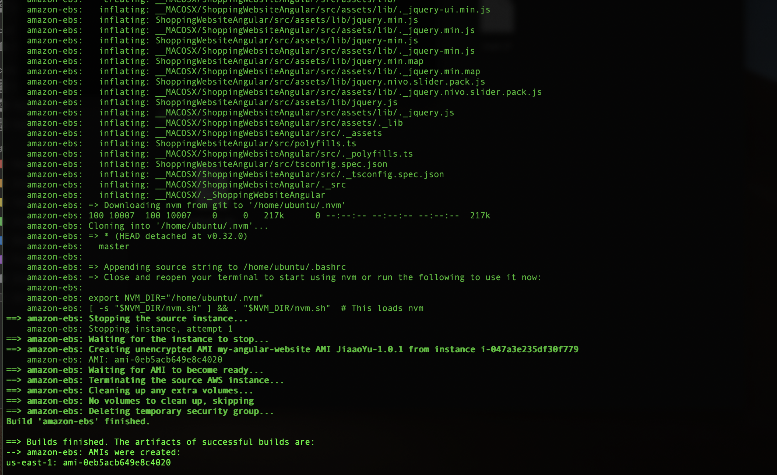

Slide 14
Thanks!

